Slide 1
ECE 471/571 – Lecture 12
Linear Discriminant Function
10/08/14

Slide 2
Road Map
Pattern Classification
Statistical Approach
Syntactic Approach
Supervised
Unsupervised
Basic concepts:
Baysian decision rule
(MAP, Likelihood ratio, Discri.)
Basic concepts:
Distance
Agglomerative method
Parametric learning (ML, BL)
k-means
Non-Parametric learning (kNN)
Winner-take-all
NN (Perceptron, BP)
Kohonen maps
Dimensionality Reduction
Fisher’s linear discriminant
K-L transform (PCA)
Performance Evaluation
ROC curve
TP, TN, FN, FP
Stochastic Methods
local optimization (GD)
global optimization (SA, GA)
ECE471/571, Hairong Qi

Slide 3
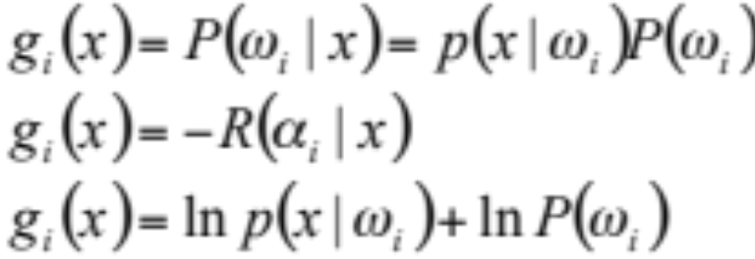
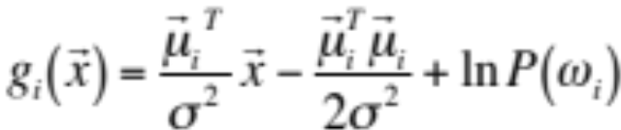
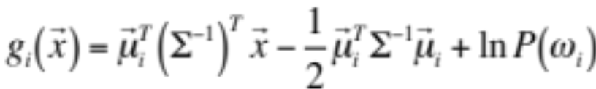
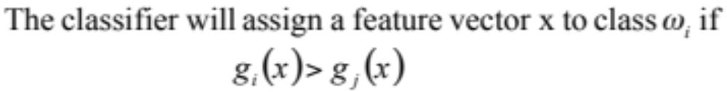
Discriminant functions - Recap
Case I:
Case II:

Slide 4
LDF
The two-category case
The multi-category case
Generalized LDF
The two-category separable case - the perceptron
  Minimizing the perceptron criterion function (focusing on misclassified samples)
  Minimum squared-error procedure -> Fisher’s Linear Discriminant (FLD)

Slide 5
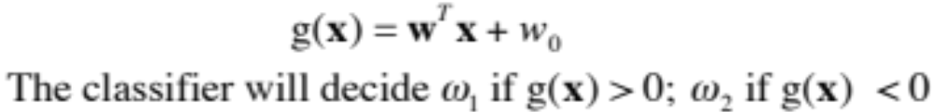
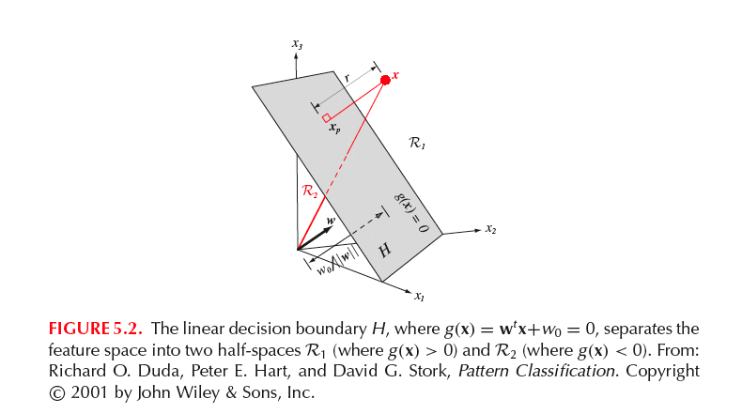
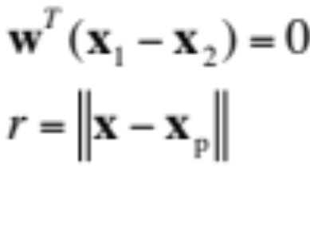
LDF - Two Category Case
Decision boundary:
Direction of H

Slide 6
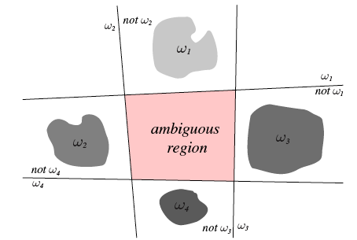
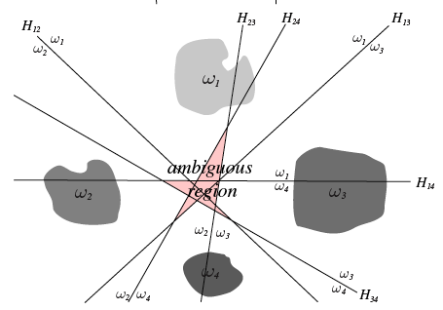
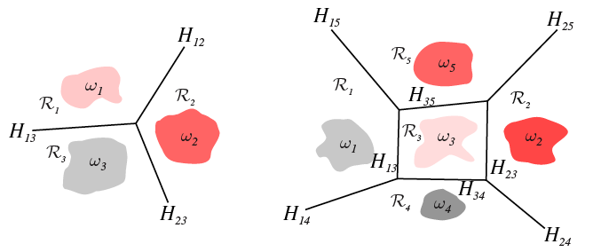
LDF - Multi-category Case
c 2-class separation (w_{i} or not w_{i})
c(c-1)/2 2-class separation (w_{i}/w_{j})
Linear machine: g_{i}(x) > g_{j}(x)

Slide 7
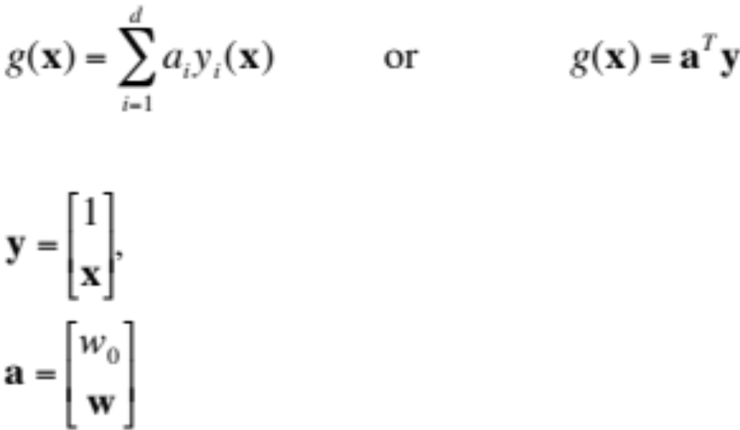
Generalized LDF
Augmented feature vector
Augmented weight vector

Slide 8
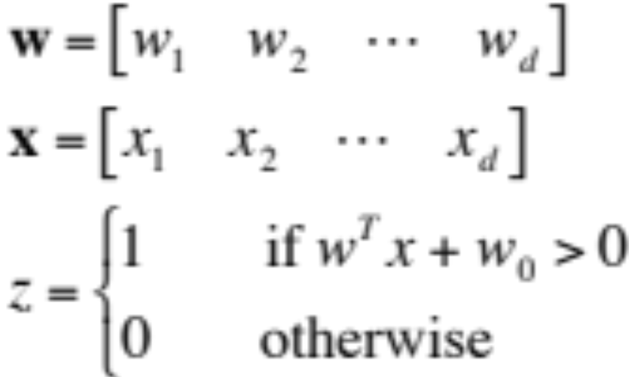
Perceptron
x₁
w₁
x₂
w₂
Σ
……
z
w_{d}
x_{d}
w₀
1
Bias or threshold

Slide 9
Perceptron
A program that learns “concepts” based on examples and correct answers
It can only respond with “true” or “false”
Single layer neural network
By training, the weight and bias of the network will be changed to be able to classify the training set with 100% accuracy

Slide 10
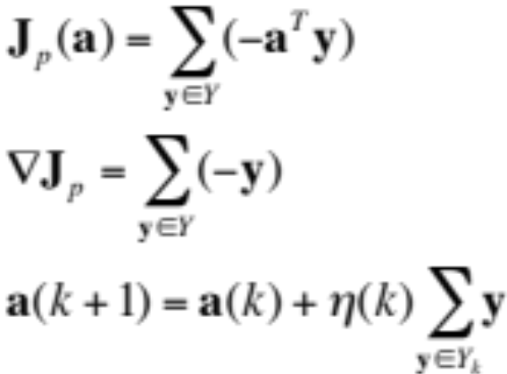
Perceptron Criterion Function
Y: the set of samples misclassified by a
Gradient descent learning

Slide 11
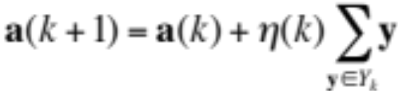
Perceptron Learning Rule
x₁
w₁
x₂
w₂
Σ
……
z
w_{d}
x_{d}
-w₀
1
w(k+1) = w(k) + Σ(T – z) x
-w₀(k+1) = -w₀(k) + Σ(T – z)
T is the expected output
z is the real output

Slide 12
Training
Step1: Samples are presented to the network
Step2: If the output is correct, no change is made; Otherwise, the weight and biases will be updated based on perceptron learning rule
Step3: An entire pass through all the training set is called an “epoch”. If no change has been made for the epoch, stop. Otherwise, go back Step1

Slide 13
Exercise (AND Logic)
x₁
w₁
w₂
z
x₂
-w₀
1
x1 x2 T
0 0 0
1 0 0
0 1 0
1 1 1
w1 w2 -w₀

Slide 14
% demonstration on perceptron
% AND gate
%
% Hairong Qi
input = 2;
tr = 4;
w = rand(1,input+1); % generate the initial weight vector
x = [0 0; 1 0; 0 1; 1 1]; % the training set (or the inputs)
T = [0; 0; 0; 1]; % the expected output
% learning process (training process)
finish = 0;
while ~finish
disp(w)
for i=1:tr
z(i) = w(1:input) * x(i,:)' > w(input+1);
w(1:input) = w(1:input) + (T(i)-z(i))* x(i,:);
w(input+1) = w(input+1) - (T(i)-z(i));
end
if sum(abs(z-T')) == 0
finish = 1;
end
disp(z)
pause
end
disp(w)

Slide 15
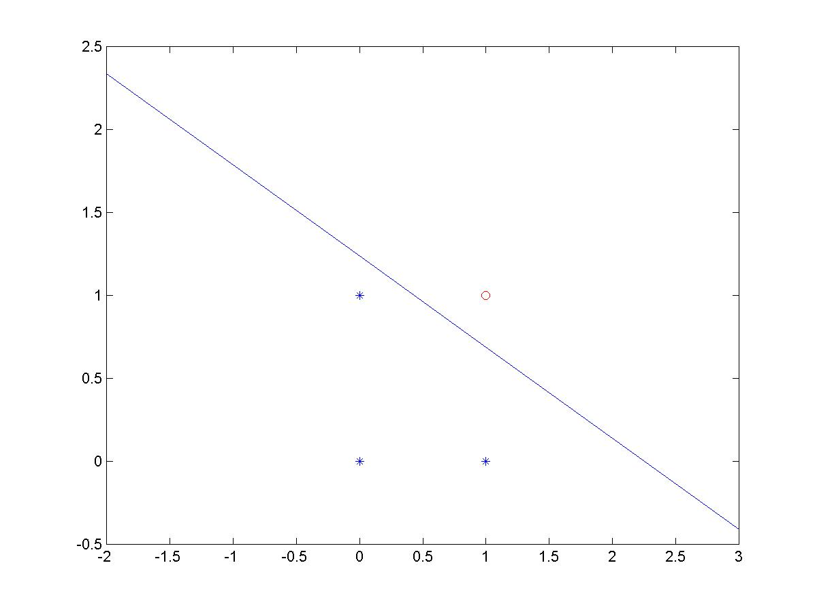
Visualizing the Decision Rule

Slide 16
Limitations
The output only has two values (1 or 0)
Can only classify samples which are linearly separable (straight line or straight plane)
Can’t train network functions like XOR

Slide 17
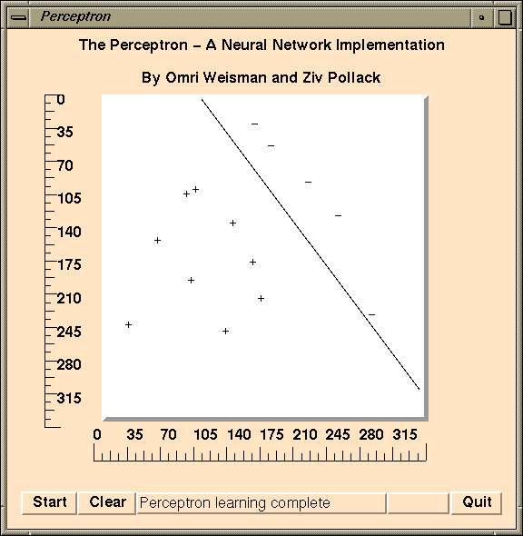
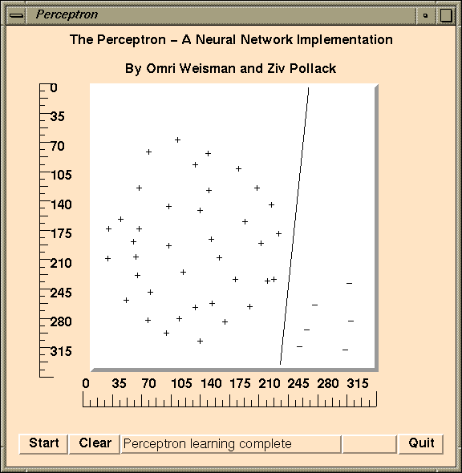
Examples

Slide 18
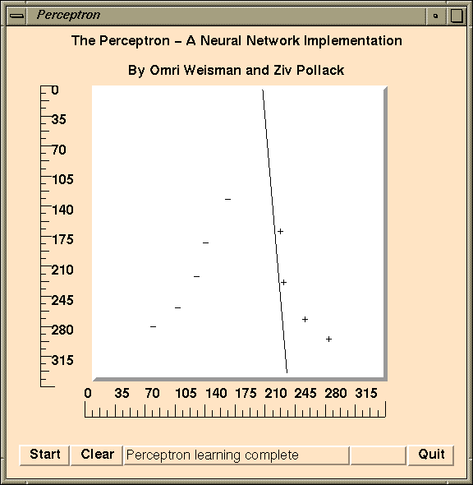

Examples

